Slide 1
An Introduction to Sorting
Chapter 8
Data Structures and Abstractions with Java, 4e
Frank Carrano
© 2015 Pearson Education, Inc., Upper Saddle River, NJ. All rights reserved.

Slide 2
Sorting
We seek algorithms to arrange items, a_{i}
such that
entry 1 ≤ entry 2 ≤ . . . ≤ entry n
Sorting an array is usually easier than sorting a chain of linked nodes
Efficiency of a sorting algorithm is significant
© 2015 Pearson Education, Inc., Upper Saddle River, NJ. All rights reserved.

Slide 3
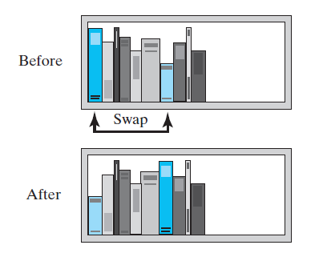
Selection Sort
FIGURE 8-1 Before and after exchanging
the shortest book and the first book
© 2015 Pearson Education, Inc., Upper Saddle River, NJ. All rights reserved.

Slide 4
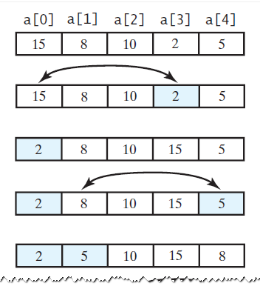
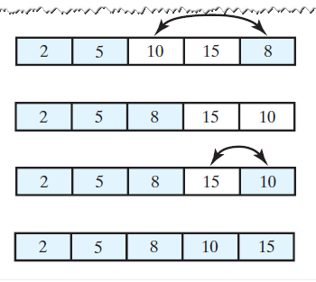
Selection Sort
FIGURE 8-2 A selection sort of an array of integers into ascending order
© 2015 Pearson Education, Inc., Upper Saddle River, NJ. All rights reserved.

Slide 5
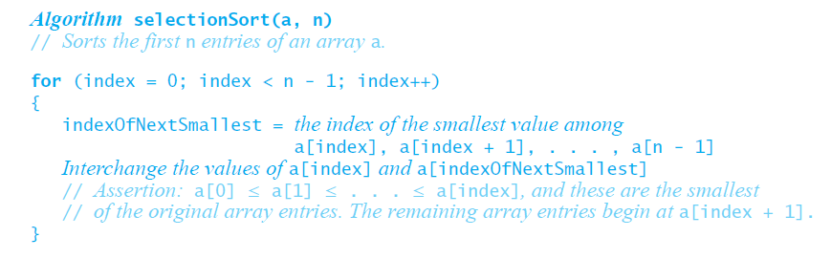
Iterative Selection Sort
This pseudocode describes an
iterative algorithm for the selection sort
© 2015 Pearson Education, Inc., Upper Saddle River, NJ. All rights reserved.

Slide 6
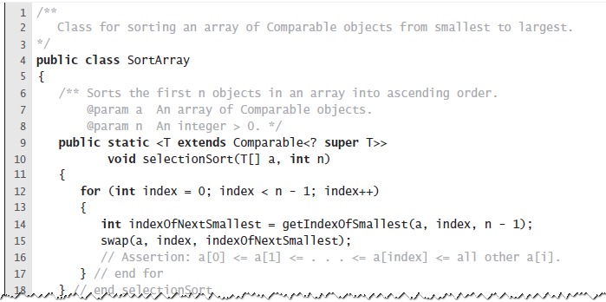
Iterative Selection Sort
LISTING 8-1 A class for sorting an array using selection sort
© 2015 Pearson Education, Inc., Upper Saddle River, NJ. All rights reserved.

Slide 7
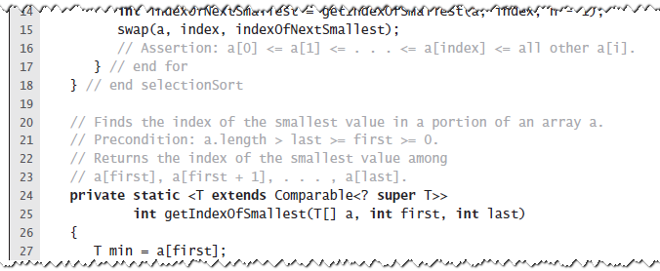
Iterative Selection Sort
LISTING 8-1 A class for sorting an array using selection sort
© 2015 Pearson Education, Inc., Upper Saddle River, NJ. All rights reserved.

Slide 8
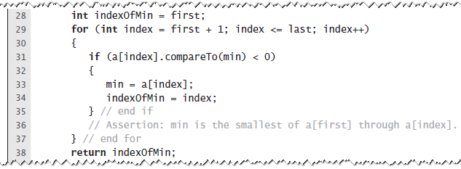
Iterative Selection Sort
LISTING 8-1 A class for sorting an array using selection sort
© 2015 Pearson Education, Inc., Upper Saddle River, NJ. All rights reserved.

Slide 9
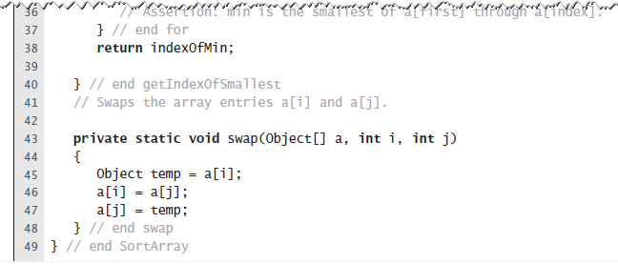
Iterative Selection Sort
LISTING 8-1 A class for sorting an array using selection sort
© 2015 Pearson Education, Inc., Upper Saddle River, NJ. All rights reserved.

Slide 10
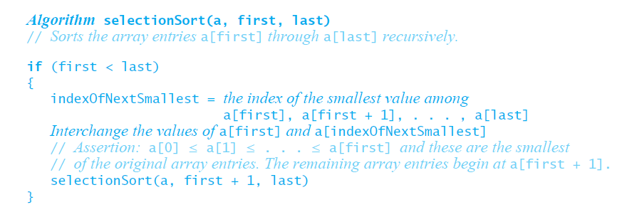
Recursive Selection Sort
Recursive selection sort algorithm
© 2015 Pearson Education, Inc., Upper Saddle River, NJ. All rights reserved.

Slide 11
Efficiency of Selection Sort
Selection sort is O(n²) regardless of the initial order of the entries.
  Requires O(n²) comparisons
  Does only O(n) swaps
© 2015 Pearson Education, Inc., Upper Saddle River, NJ. All rights reserved.

Slide 12
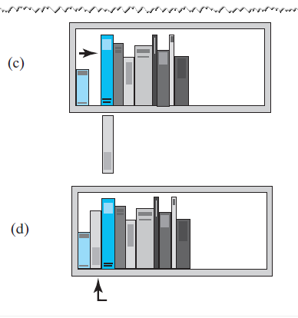
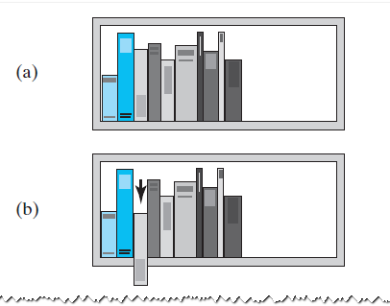
Insertion Sort
FIGURE 8-3 The placement of the
third book during an insertion sort
© 2015 Pearson Education, Inc., Upper Saddle River, NJ. All rights reserved.

Slide 13
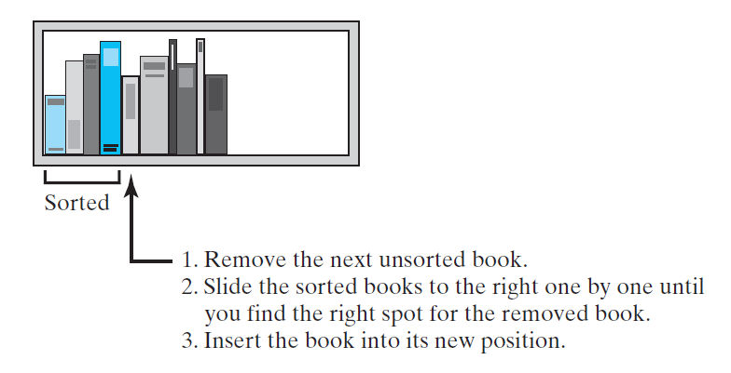
Insertion Sort
FIGURE 8-4 An insertion sort of books
© 2015 Pearson Education, Inc., Upper Saddle River, NJ. All rights reserved.

Slide 14
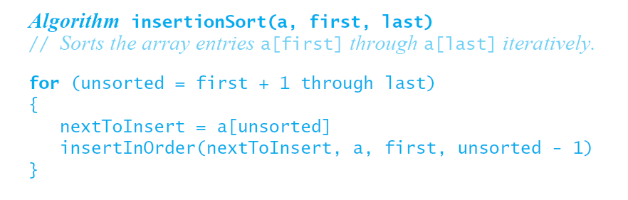
Iterative Insertion Sort
Iterative algorithm describes an insertion sort of the entries at indices first through last of the array a
© 2015 Pearson Education, Inc., Upper Saddle River, NJ. All rights reserved.

Slide 15
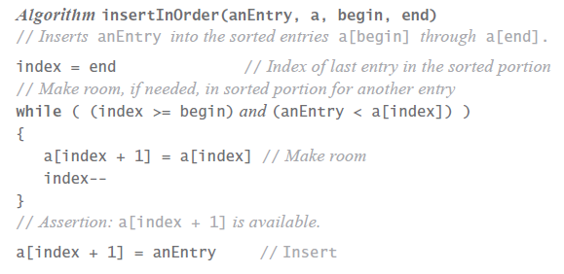
Iterative Insertion Sort
Pseudocode of method, insertInOrder,
to perform the insertions.
© 2015 Pearson Education, Inc., Upper Saddle River, NJ. All rights reserved.

Slide 16
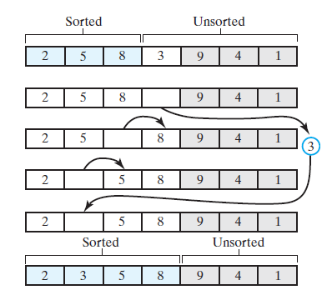
Iterative Insertion Sort
FIGURE 8-5 Inserting the next unsorted entry into its proper location within the sorted portion of an array during an insertion sort
© 2015 Pearson Education, Inc., Upper Saddle River, NJ. All rights reserved.

Slide 17
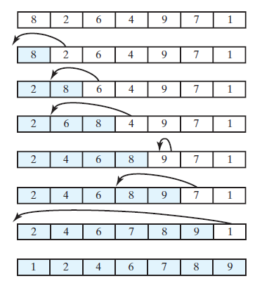
Iterative Insertion Sort
FIGURE 8-6 An insertion sort of an array
of integers into ascending order
© 2015 Pearson Education, Inc., Upper Saddle River, NJ. All rights reserved.

Slide 18
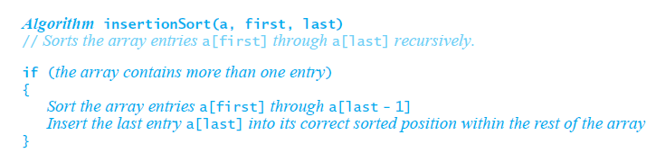
Recursive Insertion Sort
This pseudocode describes a recursive insertion sort.
© 2015 Pearson Education, Inc., Upper Saddle River, NJ. All rights reserved.

Slide 19
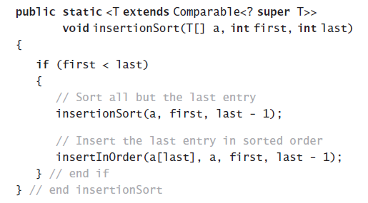
Recursive Insertion Sort
Implementing the algorithm in Java
© 2015 Pearson Education, Inc., Upper Saddle River, NJ. All rights reserved.

Slide 20
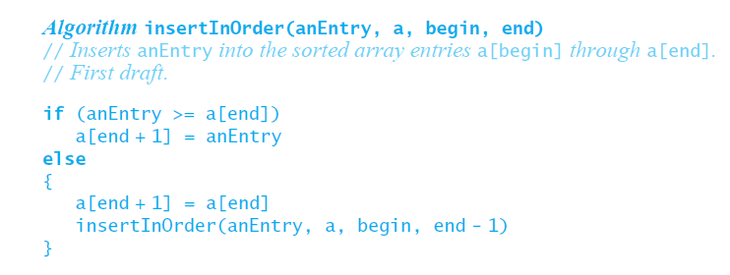
Recursive Insertion Sort
First draft of insertInOrder algorithm.
© 2015 Pearson Education, Inc., Upper Saddle River, NJ. All rights reserved.

Slide 21
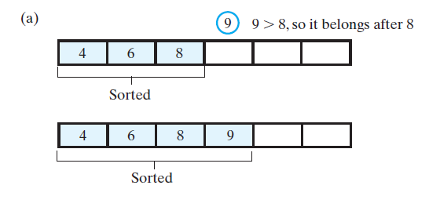
Recursive Insertion Sort
FIGURE 8-8 Inserting the first unsorted entry into the sorted portion of the array. (a) The entry is greater than or equal to the last sorted entry
© 2015 Pearson Education, Inc., Upper Saddle River, NJ. All rights reserved.

Slide 22
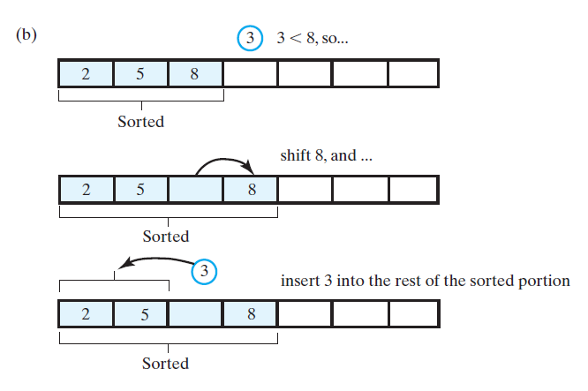
Recursive Insertion Sort
FIGURE 8-8 Inserting the first unsorted entry into the sorted portion of the array. (b) the entry is smaller than the last sorted entry
© 2015 Pearson Education, Inc., Upper Saddle River, NJ. All rights reserved.

Slide 23
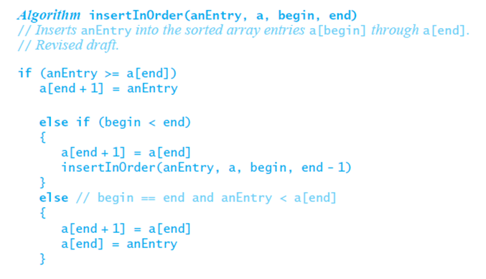
Recursive Insertion Sort
The algorithm insertInOrder: final draft.
Note: insertion sort efficiency (worst case) is O(n²)
© 2015 Pearson Education, Inc., Upper Saddle River, NJ. All rights reserved.

Slide 24
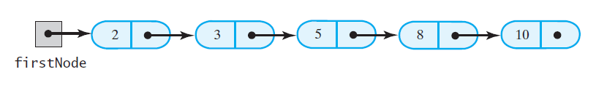
Insertion Sort of a
Chain of Linked Nodes
FIGURE 8-8 A chain of integers sorted into ascending order
© 2015 Pearson Education, Inc., Upper Saddle River, NJ. All rights reserved.

Slide 25
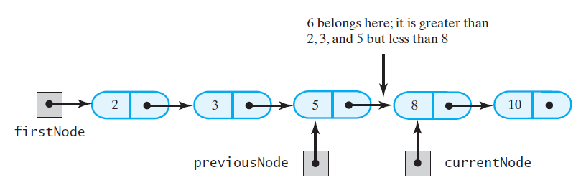
Insertion Sort of a
Chain of Linked Nodes
FIGURE 8-9 During the traversal of a chain to locate the insertion point, save a reference to the node before the current one
© 2015 Pearson Education, Inc., Upper Saddle River, NJ. All rights reserved.

Slide 26
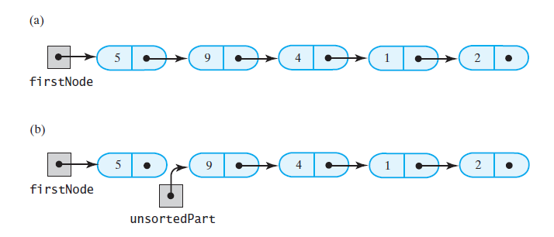
Insertion Sort of a
Chain of Linked Nodes
FIGURE 8-10 Breaking a chain of nodes into two pieces as the first step in an insertion sort: (a) the original chain;
(b) the two pieces
© 2015 Pearson Education, Inc., Upper Saddle River, NJ. All rights reserved.

Slide 27
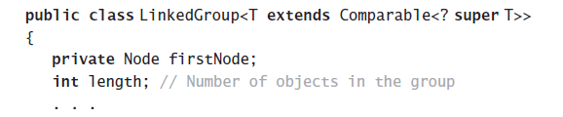
Insertion Sort of a
Chain of Linked Nodes
Add a sort method to a class LinkedGroup
that uses a linked chain to represent a certain collection
© 2015 Pearson Education, Inc., Upper Saddle River, NJ. All rights reserved.

Slide 28
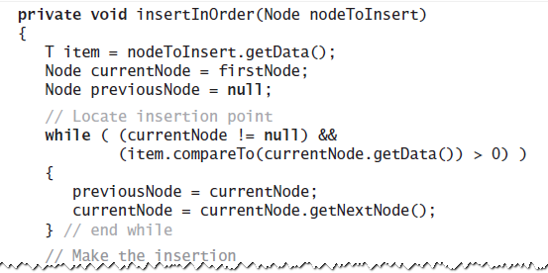
Insertion Sort of a
Chain of Linked Nodes
This class has an inner class Node that
has set and get methods
© 2015 Pearson Education, Inc., Upper Saddle River, NJ. All rights reserved.

Slide 29
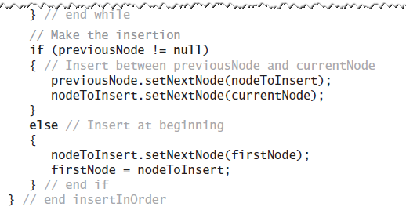
Insertion Sort of a
Chain of Linked Nodes
This class has an inner class Node that
has set and get methods
© 2015 Pearson Education, Inc., Upper Saddle River, NJ. All rights reserved.

Slide 30
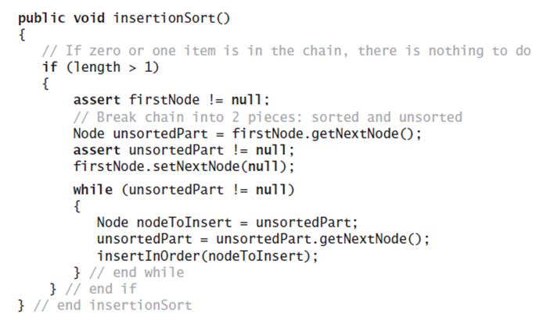
Insertion Sort of a
Chain of Linked Nodes
The method to perform the insertion sort.
© 2015 Pearson Education, Inc., Upper Saddle River, NJ. All rights reserved.

Slide 31
Shell Sort
Algorithms seen so far are simple but inefficient for large arrays at O(n²)
Note, the more sorted an array is, the less work insertInOrder must do
Improved insertion sort developed by Donald Shell
© 2015 Pearson Education, Inc., Upper Saddle River, NJ. All rights reserved.

Slide 32
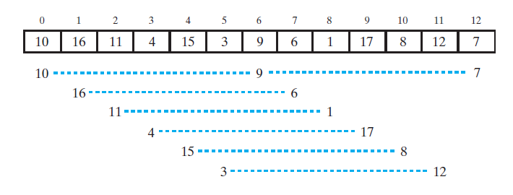
Shell Sort
FIGURE 8-11 An array and the subarrays formed by grouping entries whose indices are 6 apart.
© 2015 Pearson Education, Inc., Upper Saddle River, NJ. All rights reserved.

Slide 33
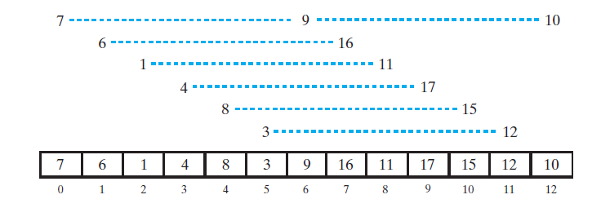
Shell Sort
FIGURE 8-12 The subarrays of Figure 8-11 after each is sorted, and the array that contains them
© 2015 Pearson Education, Inc., Upper Saddle River, NJ. All rights reserved.

Slide 34
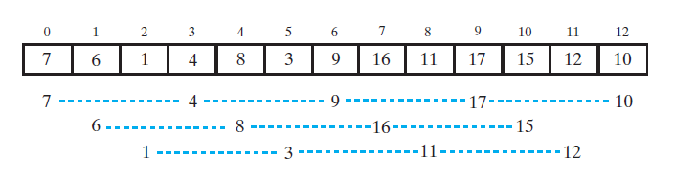
Shell Sort
FIGURE 8-13 The subarrays of the array in Figure 8-12 formed by grouping entries whose indices are 3 apart
© 2015 Pearson Education, Inc., Upper Saddle River, NJ. All rights reserved.

Slide 35
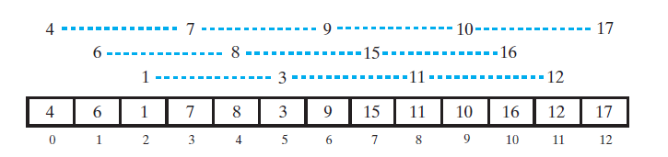
Shell Sort
FIGURE 8-14 The subarrays of Figure 8-13 after each is sorted, and the array that contains them
© 2015 Pearson Education, Inc., Upper Saddle River, NJ. All rights reserved.

Slide 36
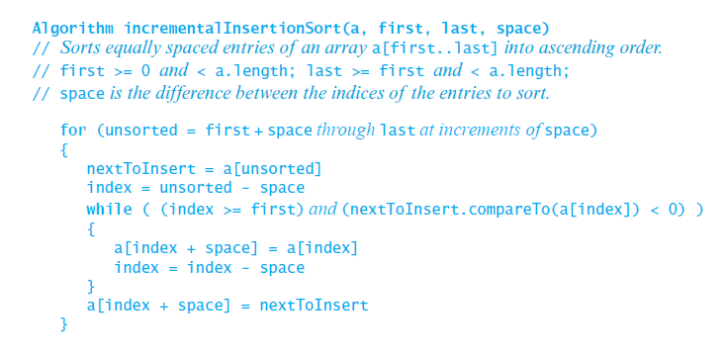
Shell Sort
Algorithm that sorts array entries whose indices are separated by an increment of space.
© 2015 Pearson Education, Inc., Upper Saddle River, NJ. All rights reserved.

Slide 37
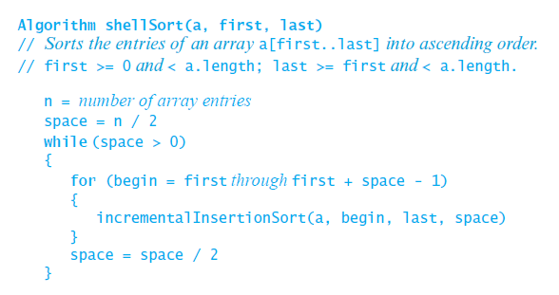
Shell Sort
Algorithm to perform a Shell sort will invoke incrementalInsertionSort and supply any sequence of spacing factors. Efficiency (worst) can be O(n^{1.5})
© 2015 Pearson Education, Inc., Upper Saddle River, NJ. All rights reserved.

Slide 38
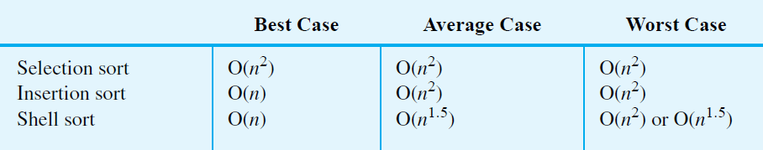
Comparing the Algorithms
FIGURE 8-16 The time efficiencies of three sorting algorithms, expressed in Big Oh notation
© 2015 Pearson Education, Inc., Upper Saddle River, NJ. All rights reserved.

Slide 39
End
Chapter 8
© 2015 Pearson Education, Inc., Upper Saddle River, NJ. All rights reserved.

